Slide 1

Restaurant Rating Application
Notes:
This is our project on “Restaurant Rating Application”

Slide 2
Background
Bangalore is the home for all kinds of restaurants.
New restaurants are opening every day with a present count of approximately 12,000.
It is difficult for a start-up to compete with already established restaurants having high customer ratings.
The key issues include type of location, cost of food, additional services, reviews.
Most importantly our application “RRA” will help new restaurants increase its “Ratings” by deciding their theme, menus, cuisine, cost etc. for a location.
Notes:
The benefits of Bangalore's infrastructure and resources led to many multinational corporations place their headquarters in city. This has also helped other business to flourish.
You get cuisines from all around the world here.
Dine-out, Pubs, Bars, Delivery, Drinks, Buffet, Desserts all kinds of options are available here.
Bengalore is best place for foodies.

Slide 3
Objective
To predict the potential rating for an upcoming restaurant in Bangalore by evaluating underlying factors:
Analyzing demography of the location.
Effect on rating depending upon the type of restaurant (café, bakery, pubs etc.)
Helping new restaurants for deciding their theme, menus, cuisine, cost etc. based on the predicted rating.
Additional facilities provided by the restaurants such as online delivery and table reservation.

Slide 4
Deliverables
PowerPoint Presentation
Project Code
Application
Technical Appendix
Visual presentation including audio.
Youtube video
Python file(.ipynb format)
Django set-up file(.txt format)
Django code folder
Work diagrams, outputs, and technical details(word file).
Notes:
There are 4 deliverables for our project.
First is the Powerpoint presentation which includes audio slides and a you tube video link.
Next is the project code which is comprised of a python file
After that we have created a web application using Django framework. A Django set up file and code folder are placed on the link given in the notes:
https://drive.google.com/drive/folders/17ZejaBl5YPiw1W7KEUcbR-IWsu0RxGMF?usp=sharing
Last we have technical appendix in a word file containing all the work diagrams, outputs and technical details of the project.

Slide 5
Project Activities
Data Modelling
Data Transformation
Data Visualization
Decision Tree
Random Forest
Linear Regression
XG Boost
Cleaning
Manipulation
Encoding
Bar Graph
Bubble Chart
Overlay Chart
Data Mining
Application
NLTK
Word cloud visualization
Django web application
Youtube video
Notes:
In the roadmap of our project, the first step was to transform our data in order to perform further analysis and find insights from it which is carried out by cleaning, manipulating and encoding techniques.
After that we have visualized the data by creating different graphs such as bar graphs, bubble chart and overlay charts.
In order to predict the “Rating” of a restaurant, different predicting models were tested by various algorithms such as Decision Tree, Random forest, Linear Regression and XG Boost on the selected features which are highly correlated with “Rating”.
Also, Data Mining is performed on the reviews given by the customers to find out the likes and dislikes using “Natural Language Tool Kit”.
Finally we have created a 3-page web application named “Restaurant Rating Application” using Django framework to predict “Rating” and to visualize effect of different features on “Rating”.
Youtube video link for this application is also embedded in slide number 34.

Slide 6
Data Transformation (Completion Date: March 14,2020)

Slide 7
Features
Book table
URL
Address
Online Order
Restaurant Type
Cuisines
Location
Rates
Dish Liked
Reviews List
Names
Cost
Phones
Type
City
Menu Item
Votes
Notes:
There are a total of 17 features in our dataset which starting from restaurant names to the reviews given by the customers.

Slide 8
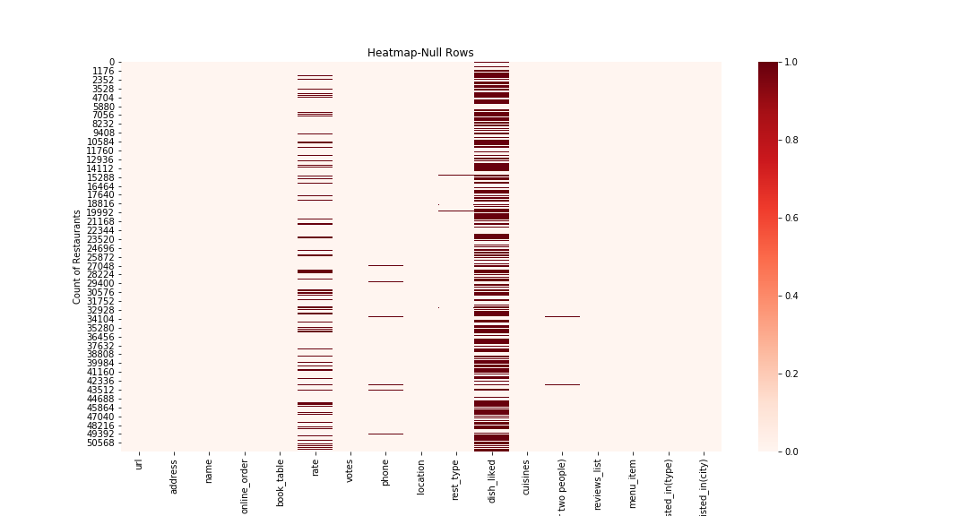
Finding Missing Data
Heatmap
x-axis: Columns
y-axis: Count of Restaurants
Observations having dark color represents null data.
Notes:
A heatmap is generated in order to inspect which columns have missing data.
From the output, we can observe that the “dish_liked” column contains the maximum missing data. So, we have dropped that column.
Additionally, we have dropped “url”, “address”and “phone number” columns because they have no use for our analysis.

Slide 9
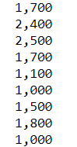
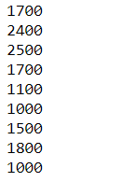
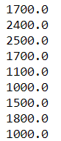
Data Cleaning
1
2
3
4
COST
COST TO STRING
REMOVED
“,”
BACK TO NUMERIC
Changed the cost column to string to remove “,”
Notes:
To perform analysis, we have cleaned our data by using simple techniques like using regular expressions(regex).
For example, the “cost” consisted of commas for values greater than 999. So, with the help of regex, we have removed “,” .
Similar data transformation techniques were performed on “reviews” and “votes”.

Slide 10
Feature Encoding
Online Order, Book Table, Location, Restaurant Type and City variables are encoded.
Example:
Online Order
No
Yes
Encoding
Online Order
0
1
Notes:
Encoding is the process of converting data from one form to another.
In order to perform data modelling techniques for prediction, we have encoded “online order”, “book table”, “location”, “restaurant type” and “city”.

Slide 11
Data Visualization (Completion Date: March 20,2020)

Slide 12
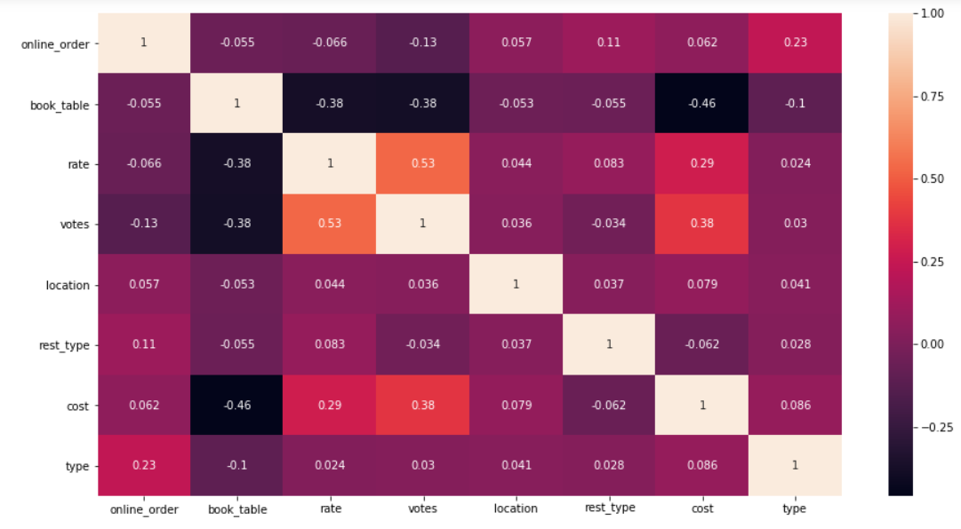
Correlation
Highly correlated:
More the number of Votes implies more rating
Notes:
The correlation heatmap depicts that the “votes” directly effect the ”rating”. Similarly, the “cost” has also an effect on the “rating”
From this heatmap, we can select the variables of our interest for our further analysis.

Slide 13
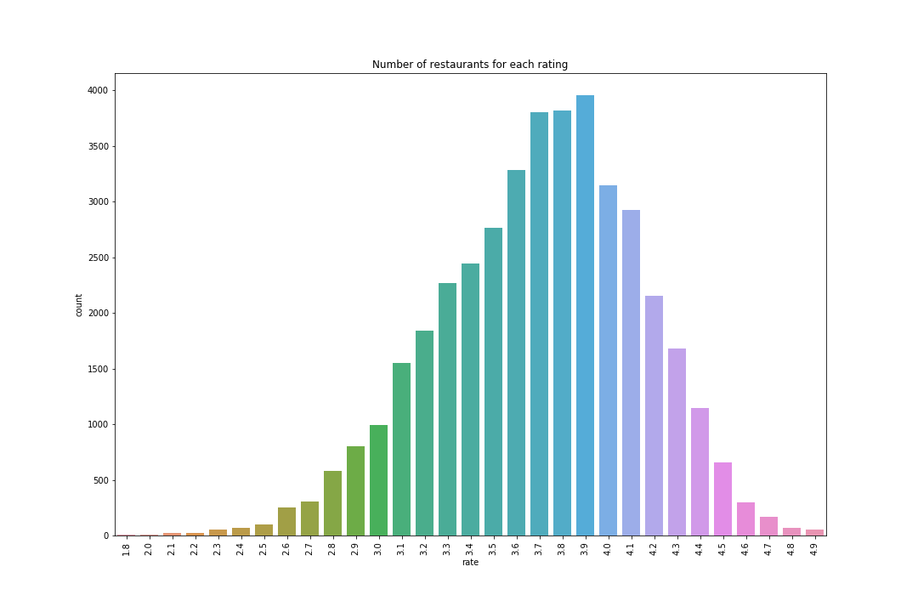
Average Rating
Majority of restaurants have an average rating of 3.9
It is tough to compete and get higher rating, hence high profit.
Notes:
The average rating of restaurants falls in the range from 3.6 to 4.0.
So, in order to compete in the market, it is a must for a new restaurant to analyze the services of existing ones.

Slide 14
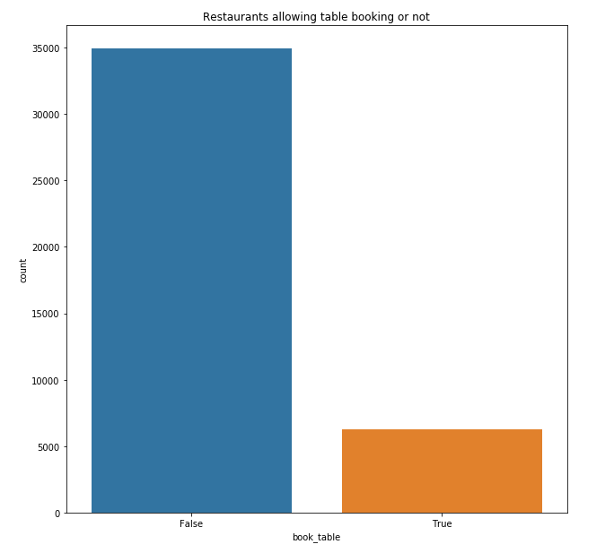
Table Reservation
Approximately 35,000 restaurants does not provide the service to reserve a table beforehand.
Notes:
First, we have looked upon the service of table reservation by the existing restaurants.
It can be observed from the graph that majority of restaurants does not provide the facility of booking a table.

Slide 15
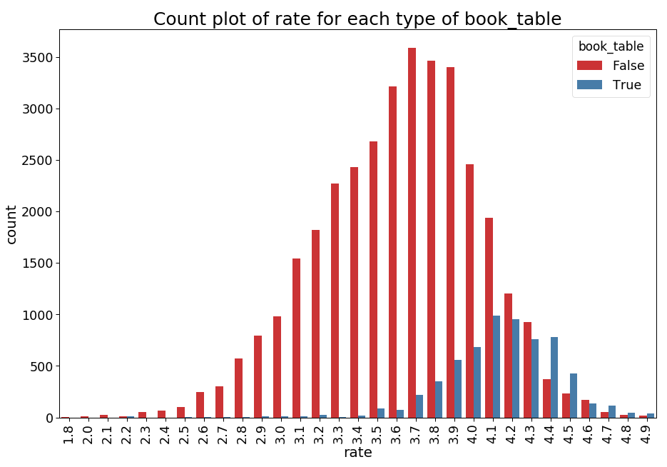
Rating vs Table Booking
Restaurants that provide the service of table reservation has more chances to get higher ratings.
Notes:
After analyzing the effect of table booking on “Rating” it can be observed that if a restaurant opts to provide the service of table reservation
then it has a positive impact on rating as seen from the graph.

Slide 16
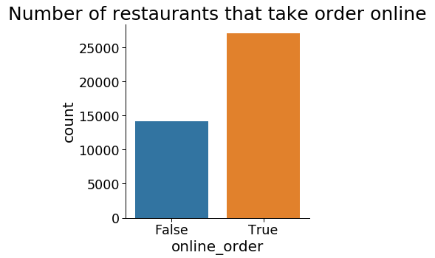
Online Order
There are more than 25000 restaurants that have the option of online order.
Notes:
Also, we have analyzed the trend of “online order” for the existing restaurants.
The count of restaurants which provide the service of online order is more than 25,000.

Slide 17
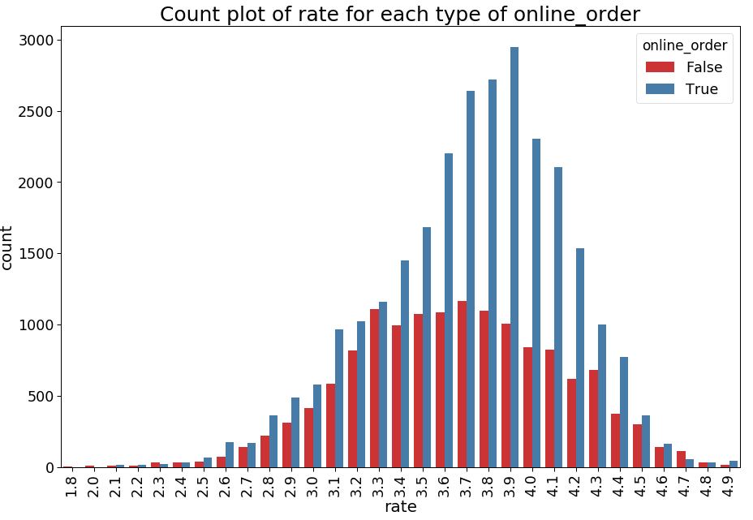
Rating vs Online Order
Restaurants that provide an option of online booking gets an average rating of 3.8
Notes:
After analyzing the impact of “online order” on “Rating” it can be observed that if a restaurant provides an option for online order
then they have a higher chance of getting better rating.

Slide 18
Data Modelling
(Completion Date: March 25,2020)

Slide 19
Feature Selection
Online Order
Restaurant Type
Votes
Rating
Location
City
Cost
Book table
Notes:
After performing, all the analysis on all the variables, we have selected “online order”, “votes”, “restaurant type”, “location”, “city”, “book table” and “cost” as our predictor variables
as they explain the maximum variance.
Where as “rating” is our response variable.

Slide 20
Regression Analysis
Random
Forest
Linear Regression
Decision
Tree
XG
Boost
Value for money
R Squared Score : 0.292
R Squared Score : 0.782
R Squared Score : 0.541
R Squared Score : 0.806
Mean Squared Error: 0.138
Mean Squared Error: 0.042
Mean Squared Error: 0.299
Mean Squared Error: 0.038
Notes:
We have performed Regression Analysis on the selected features using four different algorithms.
Among linear regression, decision tree, random forest and XG boost, the highest R-squared value is given by random forest algorithm.
So we selected Random Forest as our prediction model.

Slide 21
Data Mining
(Completion Date: March 30,2020)

Slide 22
Natural Language Processing
Frequency
Import NLTK
Stop Words
POS Tagging
Tokenizing
Distribution
WordCloud
Get a modern PowerPoint Presentation that is beautifully designed.
Removing Commonly used words such as is, and, the, for etc.
Get the frequency distribution of remaining words.
Import all the NLTK libraries:
Regex Tokenizer
Stopwords
FreqDist
Convert string sequence into pieces such as words, keywords, phrases .
Parts of Speech Tagging
Nouns
Adjectives
Verbs
Pronouns
Create word cloud based on the requirement.
Notes:
“Reviews” by the customers play an important role in analyzing customer demands, likes and dislikes.
Natural Language Processing is performed in order to extract meaningful data from the reviews like what is the most liked dish, best compliment received etc.
First step is to import NLTK libraries.
Next step is to convert sequence strings to individual words in order perform any operation. This is called as tokenizing.
Stop words are then removed from the tokenized words. The stop words are the most commonly used words such as is, am, are, the etc.
We then calculated the frequency distribution to check the occurrence of each word.
POS tagging i.e. Part of Speech tagging is done to separate the words based on their type like nouns, adjectives, verb and adverbs.
Finally we have created a wordcloud to show the data visually.

Slide 23
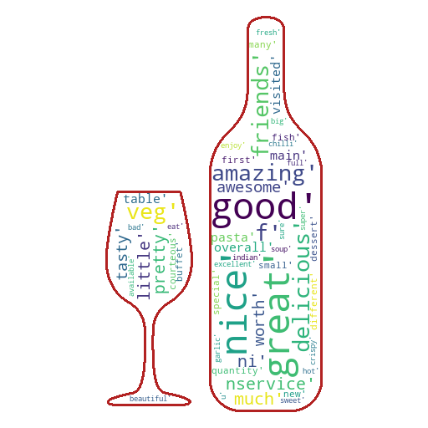
Reviews help in analyzing customer’s likes and dislikes.
Help in improving the Rating of the restaurant.
Analyze the 1-star rating to check where to improve.
4 Star Reviews
Notes:
The “adjectives” from the 4-star rating reviews were extracted to view the positive compliments received from the customers.
These compliments acts as a booster to maintain their customer satisfaction.

Slide 24
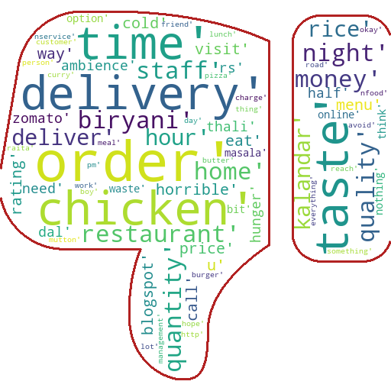
2 Star Reviews
Below are some of the factors affecting Rating:
Quality
Order
Time
Quantity
Money
Notes:
Similarly, we have extracted negative comments given by the customers in order to improve.
It can be inferred that the leading factors which decrease the rating are:
Quality
Order
Time
Quantity
Money

Slide 25
Application
(Completion Date: April 4,2020)

Slide 26
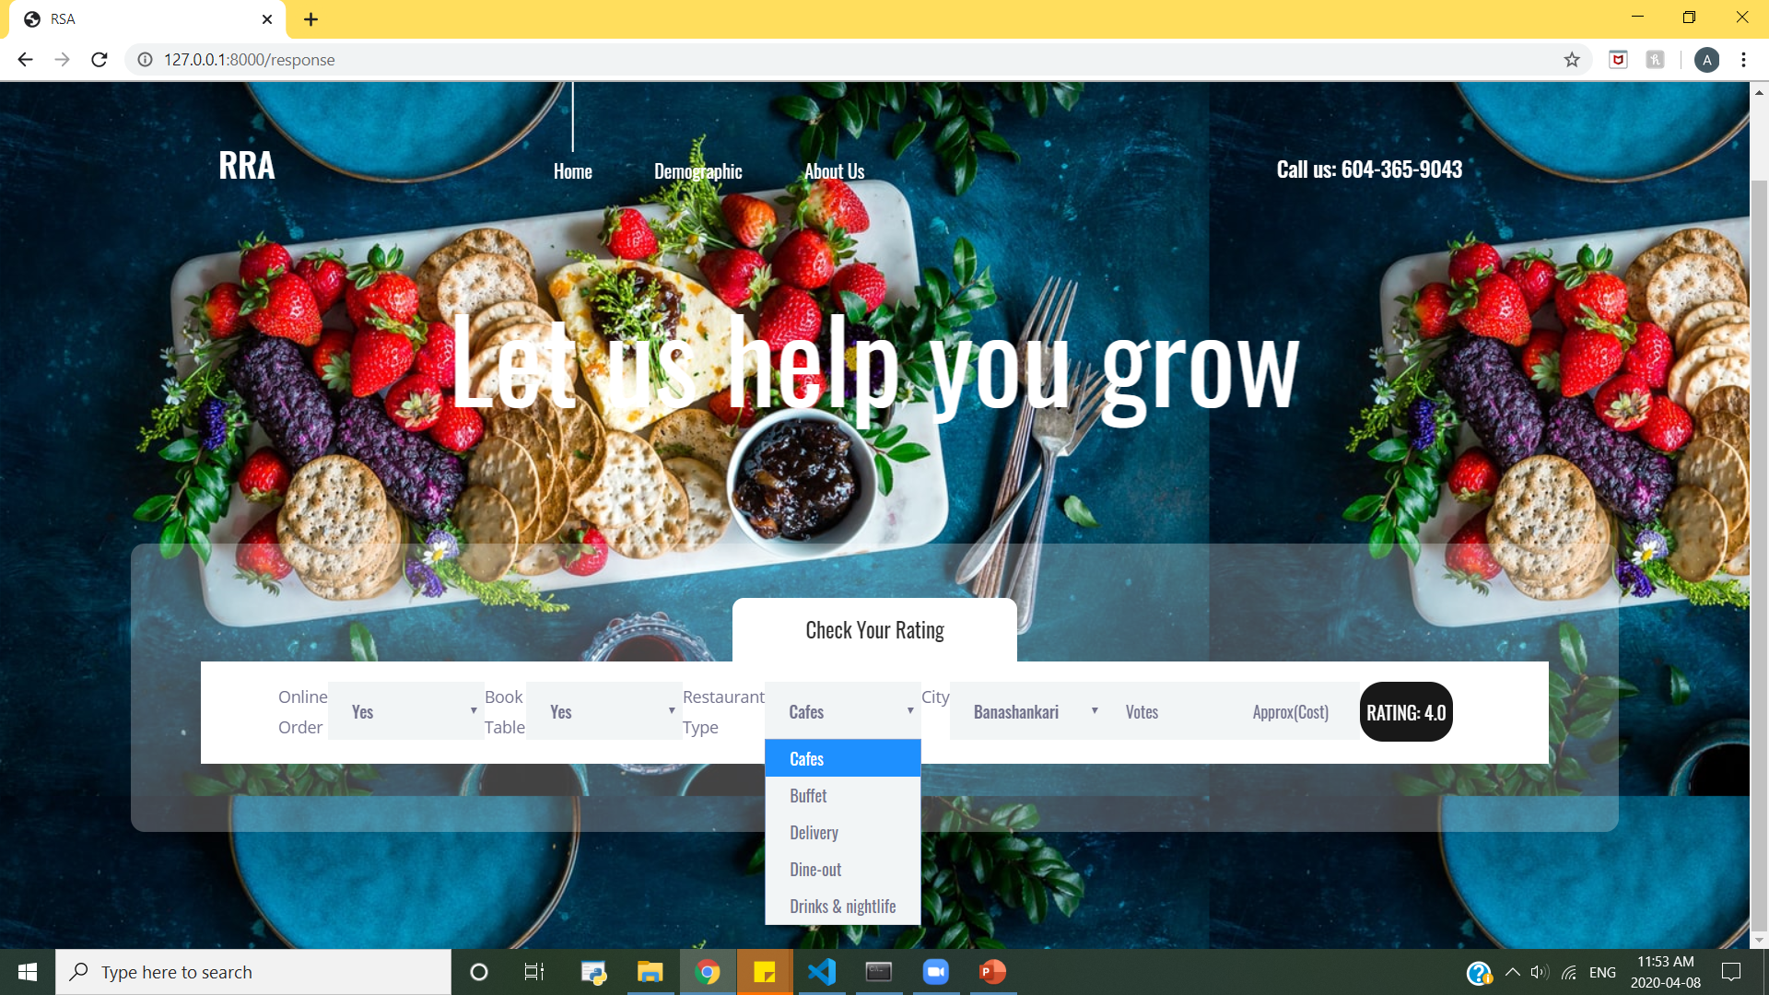
Restaurant rating application
Place your screenshot here
Web Application based on Django framework.
Input parameters:
Online Order
Book Table
Restaurant Type
City
Votes
Cost(approx.)
Notes:
Django is a Python-based open-source web framework, which follows the model-template-view (MTV) architectural pattern.
We have created a web application upon Django’s framework using python in order to predict the “rating” of a restaurant based on the selected features earlier.

Slide 27
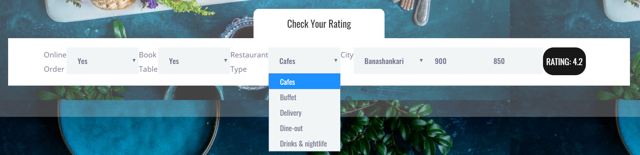
The Rate Predictor
Prediction Features
Text Input
Votes
Cost(approx.)
Dropdown Menu
Online Order
Book Table
Restaurant Type
City
Notes:
User has the option to select different options from the dropdown menus and fill in the cost and votes in the text boxes.
For example, as shown on clicking restaurant type drop down menu, we can select the restaurant type of our choice
Once a user has selected all the options and clicks on the rating button, the application will predict the restaurant rating on the button itself as shown.

Slide 28
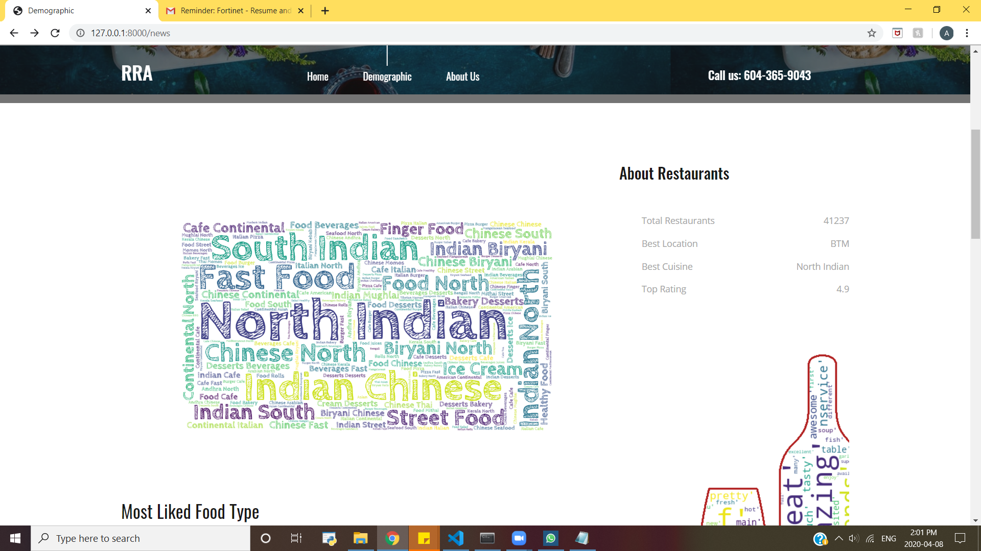
About Restaurants
Brief description about
Total Restaurants under analysis
Best Location for restaurants
Best liked Cuisine
Top Rating
Notes:
The “Demographic” page of our application shows different visualization.
Starting with the “About Restaurants”, it provides a general summary of:
Total Restaurants
Best Location
Best Cuisine
Top Rating

Slide 29
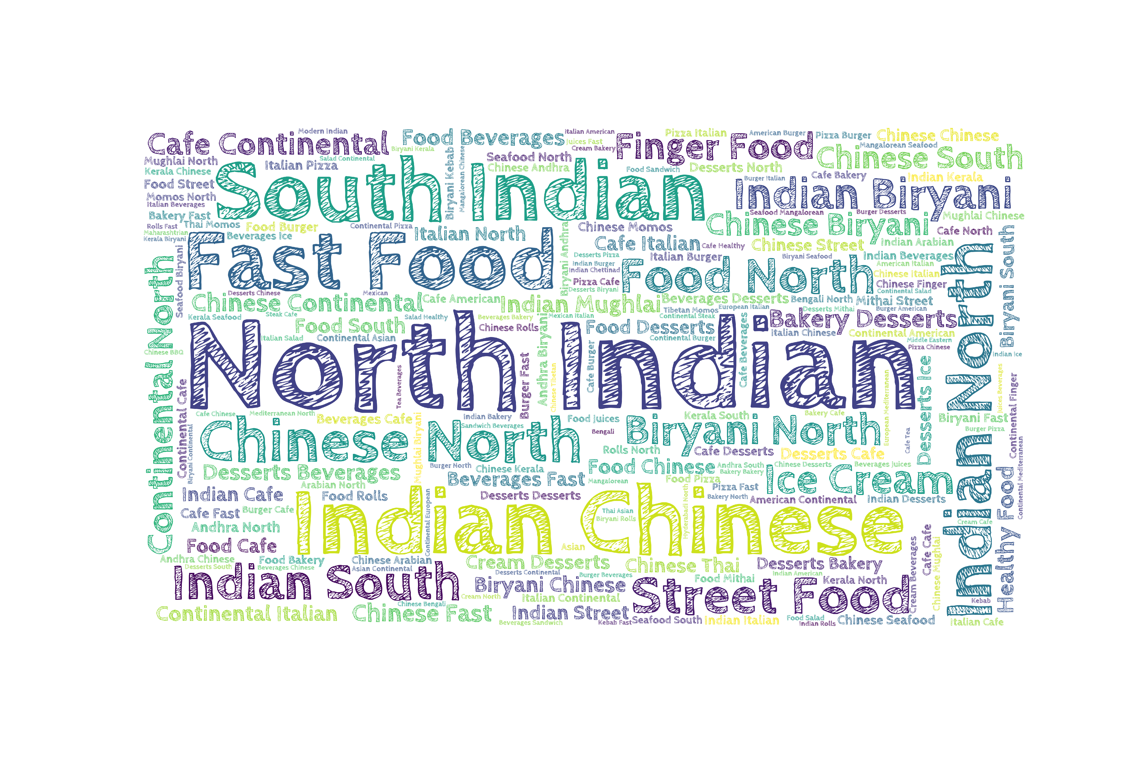
A picture explain more than words
Clearly North Indian Food is the most preferred food type among people.
Notes:
A word cloud is also generated using NLTK which suggests that the “North Indian” is the most liked cuisine followed by “South Indian” and “Indian Chinese“
amongst people visiting the restaurants in Bangalore.

Slide 30
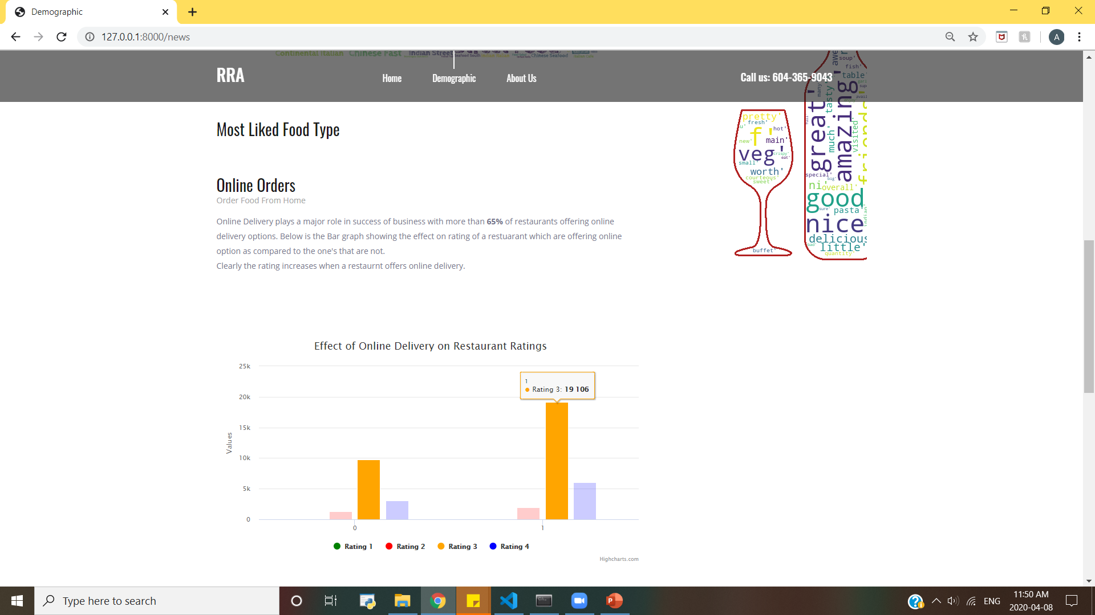
Text data to give more details and brief introduction about the graphs.
Bar Graph showing visualizations that will help understand about different aspects of data.
Notes:
Text Summary provide a brief information about the graphs.
A dynamic bar graph is created with a combination of highchart libraries and python which shows the effect of online delivery on restaurant rating.

Slide 31
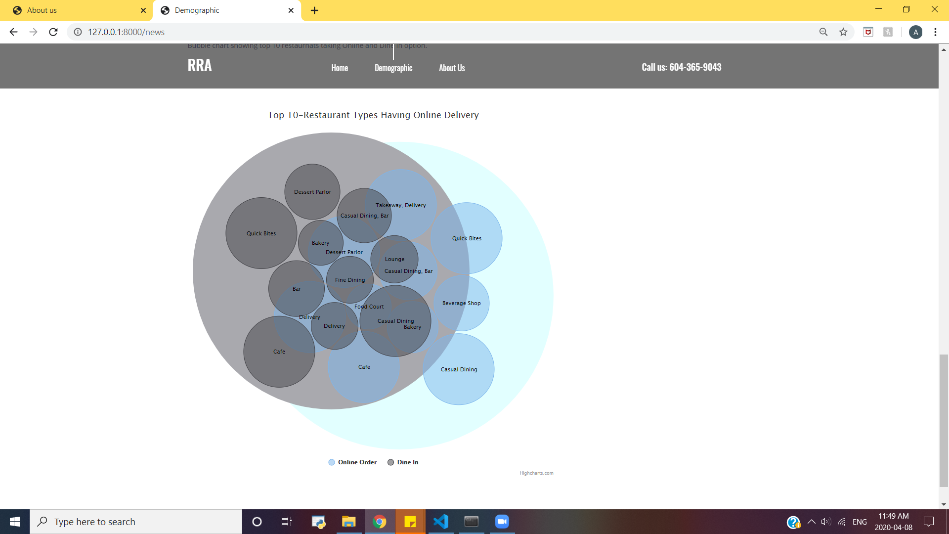
Movable bubble chart to dynamically visualize the data.
Notes:
Additionally, we have created dynamic bubble chart that depicts the top 10 restaurant taking only “Online Order” and the restaurants that have “Dine In” facility only.

Slide 32
Key Findings
Online Booking
2- Star rating
Restaurant providing online booking gets higher rating.
Money, Quality of Food, Order,Quantity were the factors resulting in 2 star rating
Type of Restaurant
Table Booking
Pubs and bars has the highest rating as compared to other types of restaurants.
Restautants accepting table booking has high rating as compared to others
Preferred Cuisine
Location
North Indian cuisine stood out as the best cuisine for Bangalore people.
“BTM” is the most preferred restaurant spot.

Slide 33

Limitations
No prior demographic knowledge of Bangalore.
Dataset had large variation resulting in no compact and well-separated clusters.
Biased reviews from customers resulting in incorrect prediction analysis.
Restricted number of hits on Zomato API to fetch updated data.
Geo-plots could not be visualized due to paid Google API services.

Slide 34

Application Demo click on the button below
Notes:
A YouTube video demonstrating working of the application is also created. Click on the button to view the video.
Video Link
https://youtu.be/2HRDyCy2HhI

Slide 35
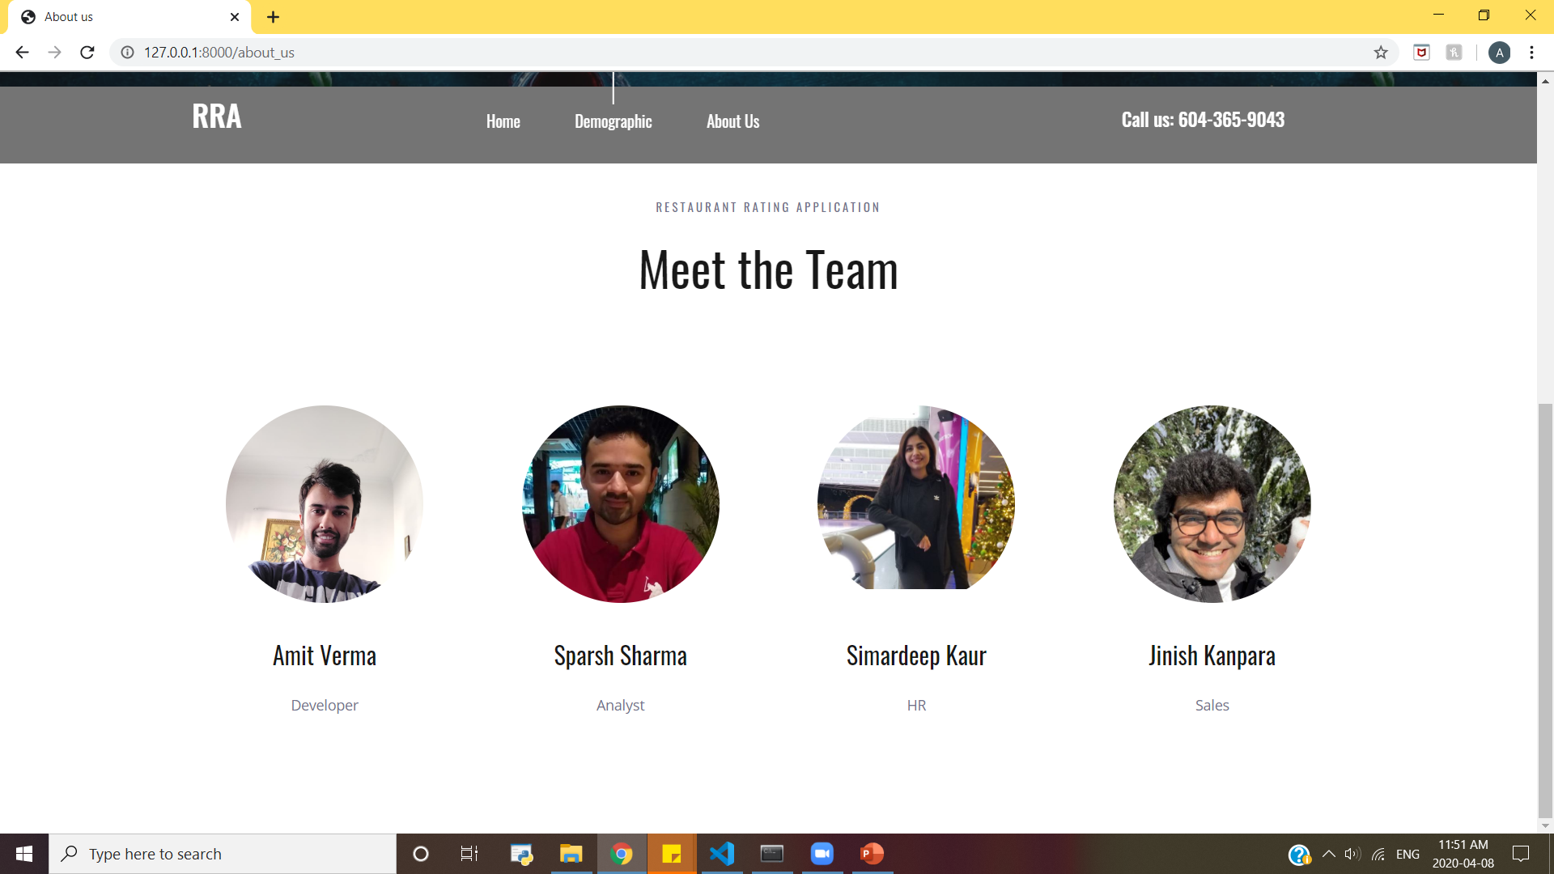
Notes:
Sparsh Sharma | 100329093
Simardeep Kaur |100329207
Jinish Kanpara | 100330202
Amit Verma | 100329477

Slide 36
Technical Appendix
Python Libraries Used
Data Cleaning
Data Transformation
Algorithm Used
NLTK
Notes:
Note: Double Click on word icon to open the file.
A word file is also submitted separately in case the file doesn't open from the above link.

Slide 37
Thanks!
Any questions?
You can find us at:
rra@gmail.com

